Slide 1
Climate Change project update: week 1
Rens Breunissen,
Lotte van Dongen, Markus Peschl,
Cecilia Casolo,
Maaike Elgersma,
Eva Slingerland,
Simon van Oosterom
Supervised by
Lorinc Meszaros [Deltares]
Robbert Fokkink [TU Delft]
Mathematical Data Science

Slide 2
Content
Results from Pre-analysis
Possible research questions

Slide 3
Pre-analysis

Slide 4
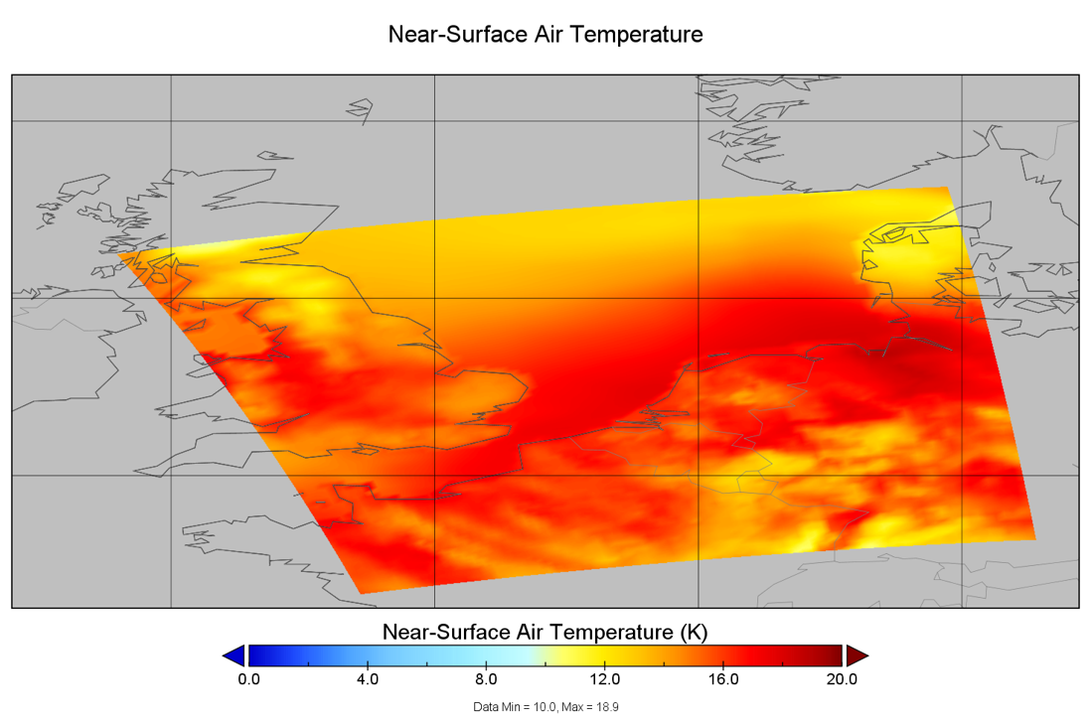
1: Temperature map from one moment in time

Slide 5
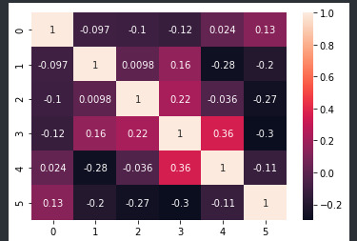
2) Correlation between variables
Cloud cover and surface preasure correlate with almost all other variables.
To do: Split the correlation up in different years (or periods of 10 years) and different seasons/months

Slide 6
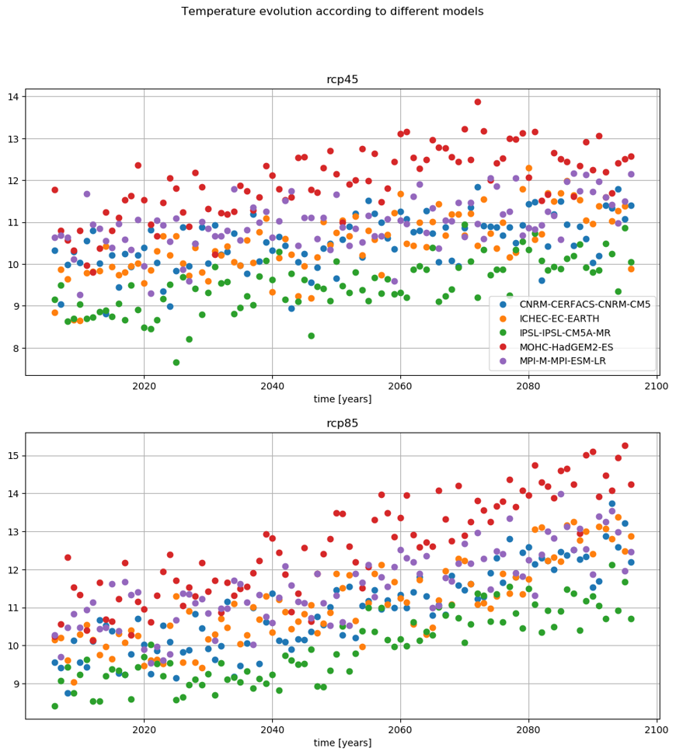
3) Temperature evolution
Yearly average of the temperature increases (obviously) for all models and scenarios.
Distribution of the temperature will be shown in the next slides

Slide 7
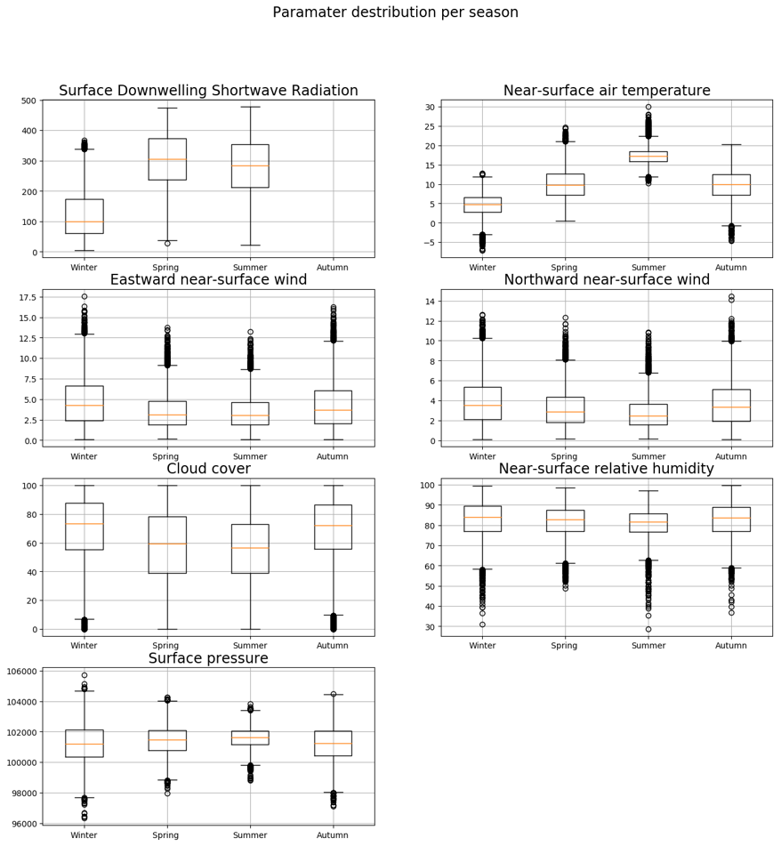


4) Evolution of the distribution of the variables
Boxplots of all variables aggregated over the whole time period

Slide 8
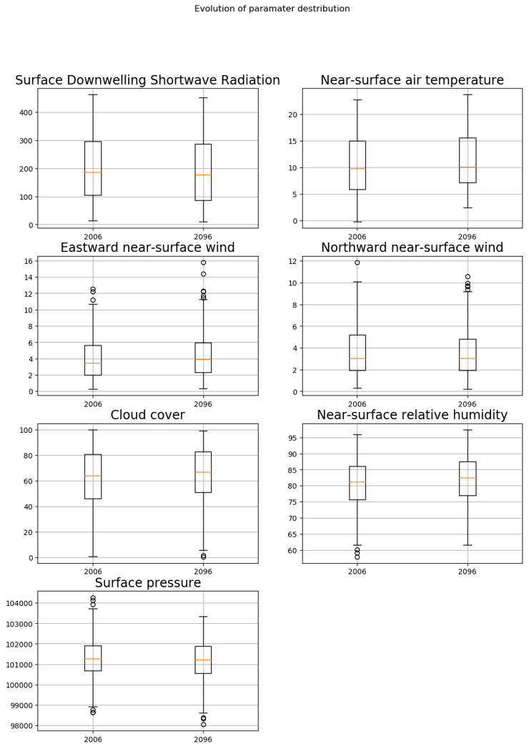
4) Evolution of the distribution of the variables
Comparing 2006 and 2096 as a whole

Slide 9
4) Evolution of the distribution of the variables
Idea: one year is still a relatively small period. As seen in point 3 (time-series plot) the average temperature fluctuates
So, this is the distribution of the variables over a period of 10 years, 2006-2016 and 2086-2096.

Slide 10
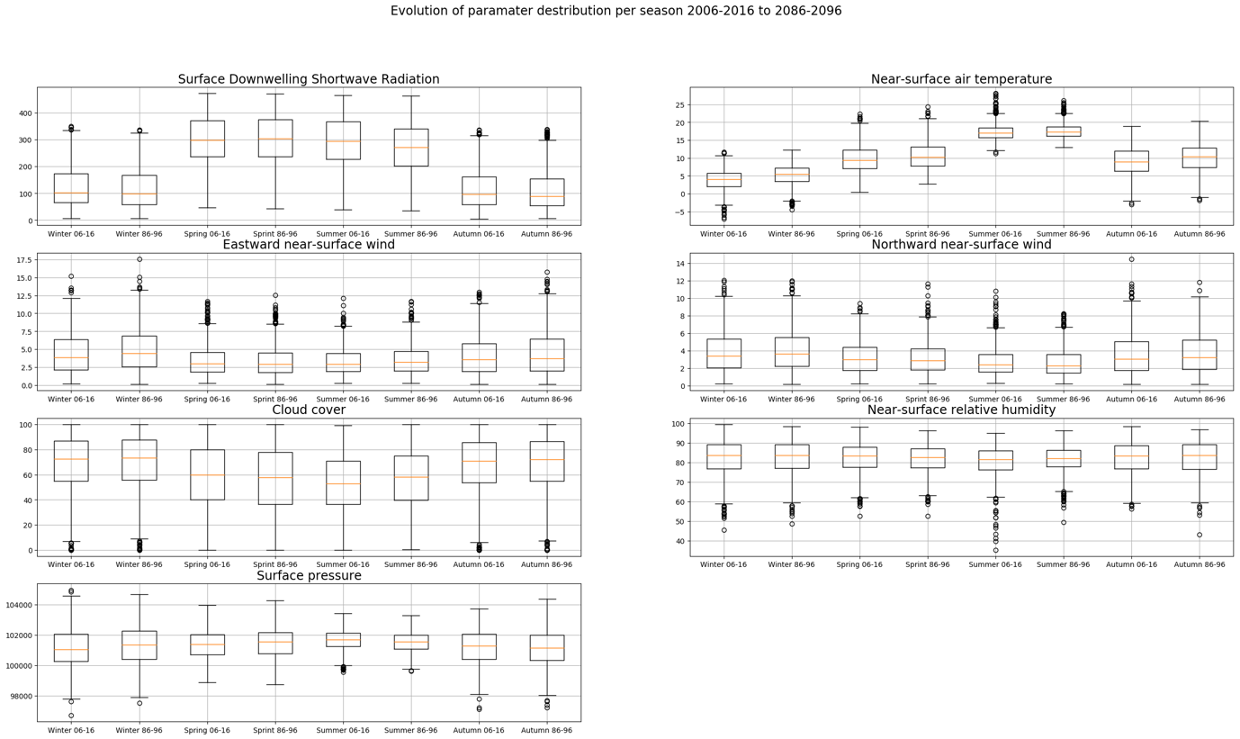
4) Evolution of the distribution of the variables
Idea: The yearly distribution hides seasonal variations in the parameters
So, give a boxplot of the distribution of the parameters per season and over a ten year period.
As can be seen, surprisingly, the temperature distribution in the first period is more spread out then in the last period.
Notice that the wind takes on only positive values?

Slide 11
Research questions

Slide 12
Options
See if we can correlate different variables, does this correlation change over the years/seasons?
See if we can cluster the points in different groups, do the characteristics of these clusters change over the years/seasons?
See if we can compare / correlate different prediction models and experiments, do they present similar characteristics? How can we describe differences between them?

